Slide 1
Applications
of
Linear System

Slide 2

Real-World Problem: Allocating Computing Resources in a Data Center
A cloud computing company provides virtual machines (VMs) to different clients. The company has three types of computing resources:
CPU cores
RAM in GB
Storage in TB
Each client request requires a specific combination of these resources. The data center must allocate resources efficiently while ensuring all resources are fully utilized.
$x=$

Slide 3


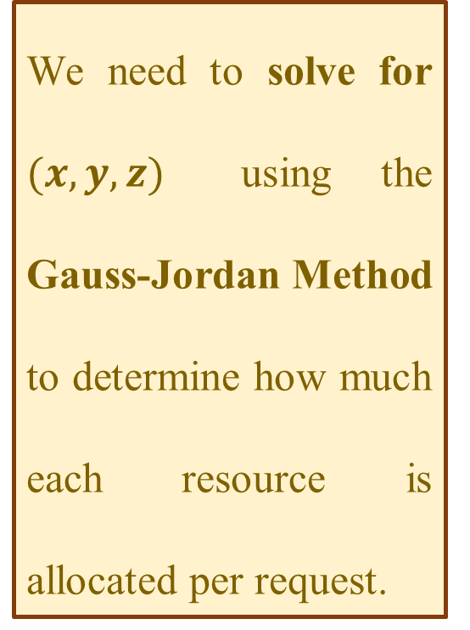

Problem Setup: Resource Allocation as a System of Linear Equations
The company receives three client requests, and the total available resources are:
60 CPU cores . 130 GB RAM . 100 TB Storage
Each client's request results in a system of three equations:
$x$ represents the number of times Client 1's request is fulfilled.
We need to solve for $(x, y, z)$ using the Gauss-Jordan Method to determine how much each resource is allocated per request.
$y$ represents the number of times Client 2's request is fulfilled.
$z$ represents the number of times Client 3's request is fulfilled.
1️⃣ Client 1: Requests 10 CPU cores, 20 GB RAM, and 30 TB Storage
2️⃣ Client 2: Requests 10 CPU core, 10 GB RAM, and 20 TB Storage
3️⃣ Client 3: Requests 10 CPU cores, 30 GB RAM, and 10 TB Storage
$$10x+10y+10z=60$$
$$20x+10y+30z=130$$
$$30x+20y+10z=100$$

Slide 4
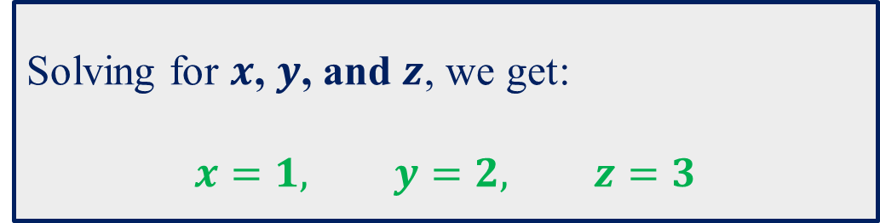
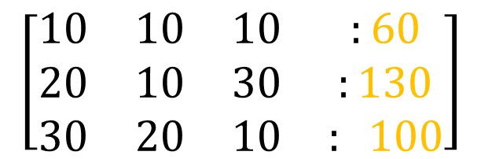
Solution using Gauss-Jordan Elimination Method
We represent the system as an augmented matrix:
$$\left[\begin{matrix}10 & 10 & 10 & :60 \\ 20 & 10 & 30 & :130 \\ 30 & 20 & 10 & : 100\end{matrix}\right]$$
Solving for $x$, $y$, and $z$, we get:
$$x=1, y=2, z=3$$

Slide 5
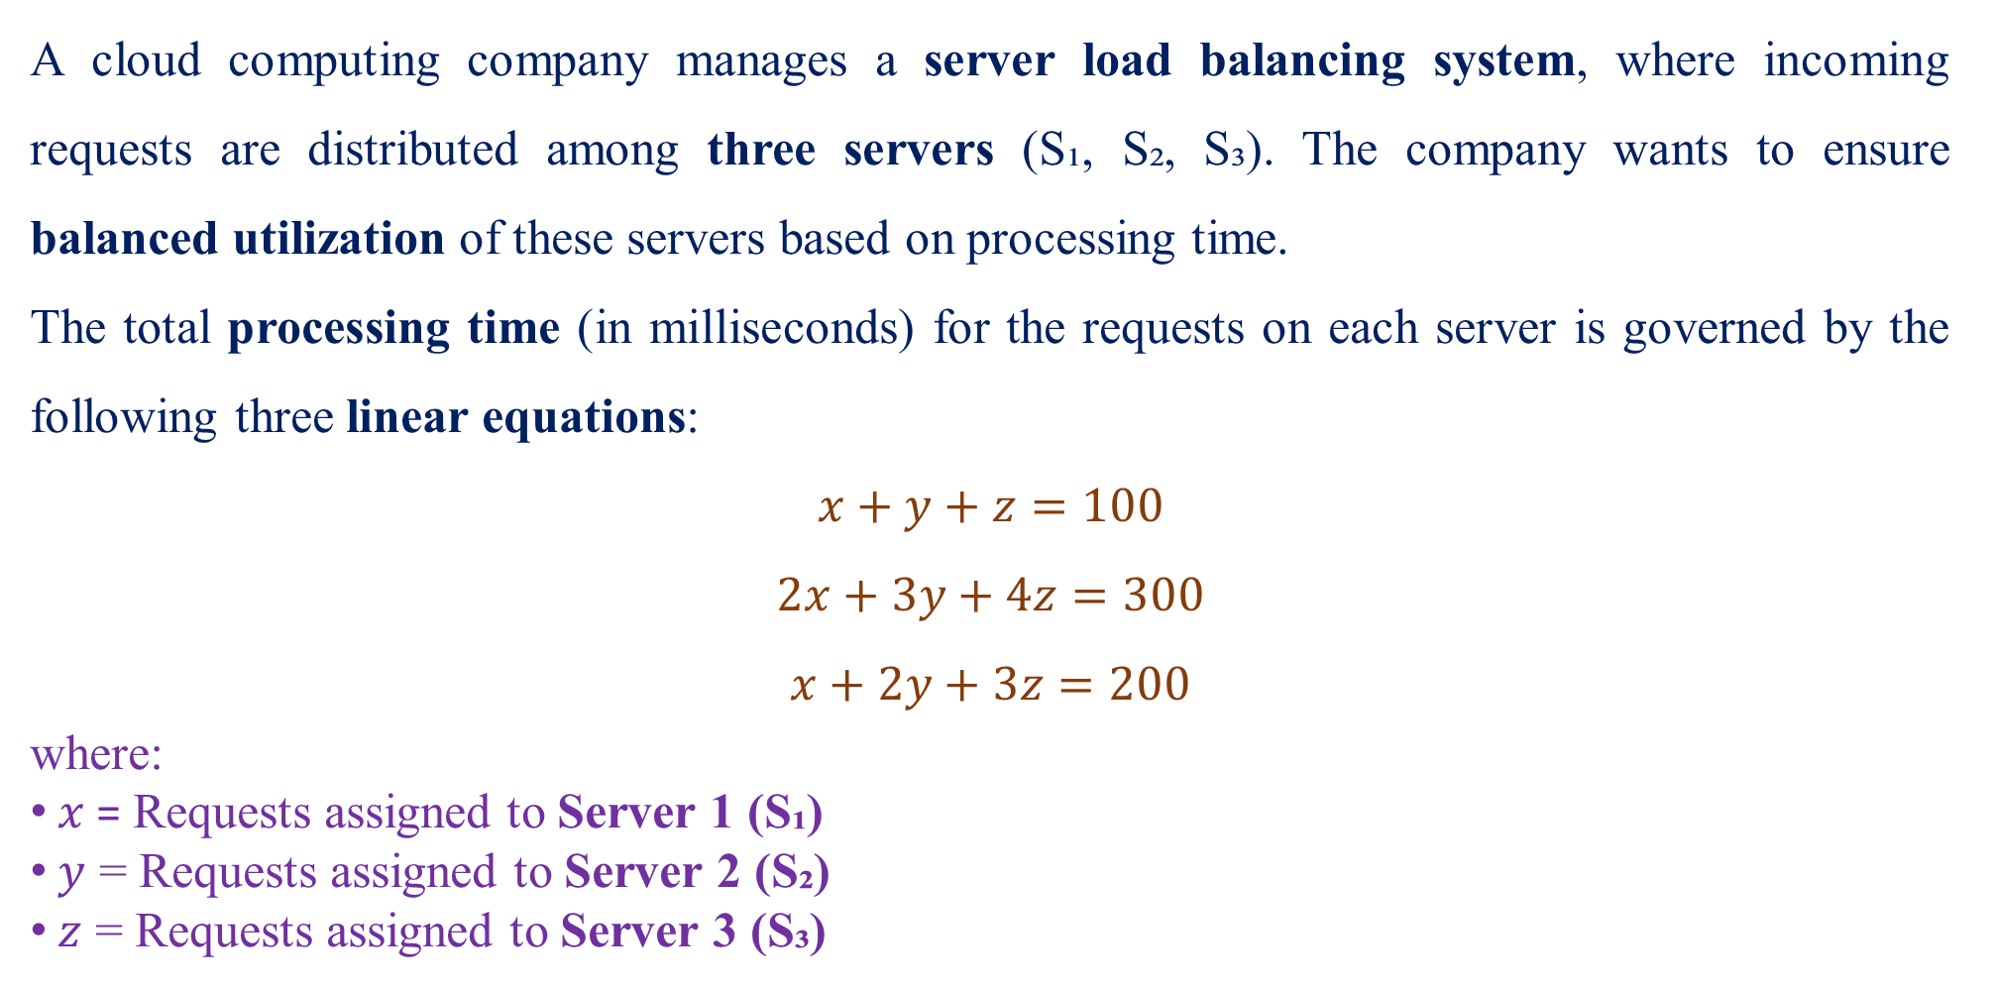
2. Server Load Balancing Optimization
A cloud computing company manages a server load balancing system, where incoming requests are distributed among three servers (S₁, S₂, S₃). The company wants to ensure balanced utilization of these servers based on processing time.
The total processing time (in milliseconds) for the requests on each server is governed by the following three linear equations:
$$x+y+z=100$$
$$2x+3y+4z=300$$
$$x+2y+3z=200$$
where:
$x$ = Requests assigned to Server 1 (S₁)
$y$ = Requests assigned to Server 2 (S₂)
$z$ = Requests assigned to Server 3 (S₃)

Slide 6
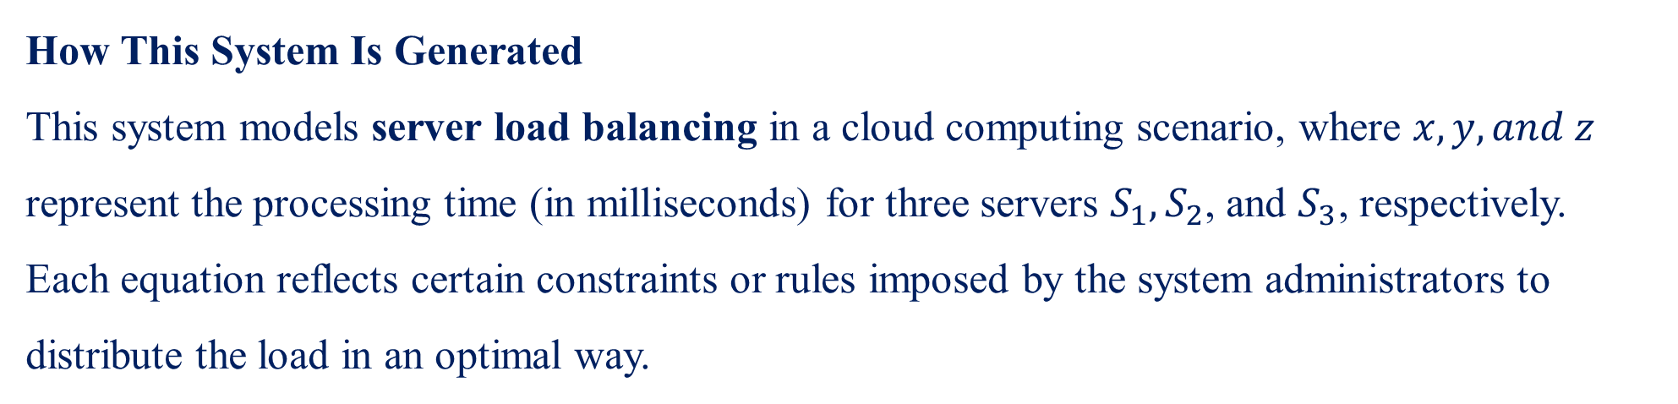
How This System Is Generated
This system models server load balancing in a cloud computing scenario, where $x, y, and z$ represent the processing time (in milliseconds) for three servers $S_{1}​, S_{2​}$, and $S_{3}$​, respectively.
Each equation reflects certain constraints or rules imposed by the system administrators to distribute the load in an optimal way.
$$x+y+z=100$$
This represents the total load constraint across all servers.
Example interpretation: The total processing time of incoming tasks distributed to the servers must sum up to 100 milliseconds.

Slide 7


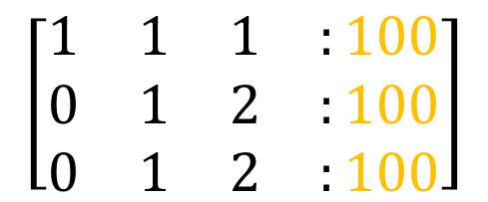


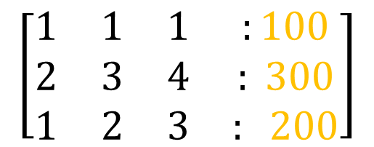




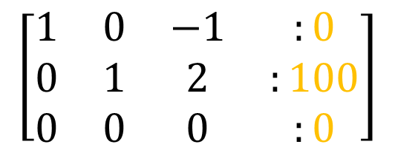


Solution using Gauss-Jordan Elimination Method
We represent the system as an augmented matrix:
$$\left[\begin{matrix}1 & 1 & 1 & :100 \\ 2 & 3 & 4 & : 300 \\ 1 & 2 & 3 & : 200\end{matrix}\right]$$
Rewriting as equations:
$$x−z=0⇒x=z$$
$$y+2z=100⇒y=100−2z$$
$$\left[\begin{matrix}1 & 1 & 1 & :100 \\ 0 & 1 & 2 & :100 \\ 0 & 1 & 2 & :100\end{matrix}\right]$$
$$R_{2}−2∗R_{1}$$
Let $z=t$ (since it can take any real value).
$$R_{3}−R_{1}$$
Thus the solution is:
$$x=t$$
$$\left[\begin{matrix}1 & 0 & −1 & :0 \\ 0 & 1 & 2 & :100 \\ 0 & 0 & 0 & :0\end{matrix}\right]$$
$$R_{1}−R_{2}$$
$$y=100−2t$$
$$R_{3}−R_{2}$$
$$z=t$$
Since z can take any real value, there are infinitely many solutions, meaning multiple ways to distribute requests across the servers.

Slide 8


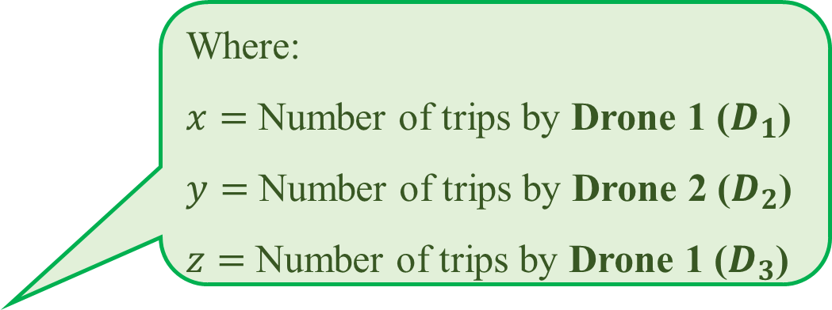

Real-World Scenario for No Solution Case (Inconsistent System)
A drone delivery company is managing flight routes for three drones (D₁, D₂, and D₃) that deliver packages across three cities (City A, City B, and City C). Due to specific fuel, time, and distance constraints, they try to solve a set of conditions that govern how many trips each drone can make per day.
Where:
$x=$ Number of trips by Drone 1 ($D_{1}$)
$y=$ Number of trips by Drone 2 ($D_{2}$)
$z=$ Number of trips by Drone 1 ($D_{3}$)
The company sets the following constraints based on drone capacity, flight range, and operational limits:
1️⃣ The total number of trips made by all drones must equal 50 trips per day:
$$x+y+z=50$$
2️⃣ Due to fuel limitations, the combined total of trips by Drone 1 and Drone 2 must be 60 trips:
$$x+y=60$$
3️⃣ A delivery quota requires Drones 2 and 3 to make a total of 30 trips:
$$y+z=30$$

Slide 9
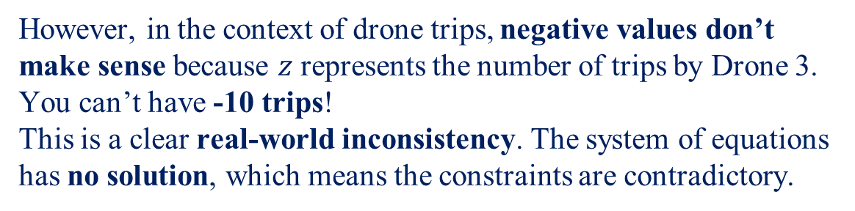
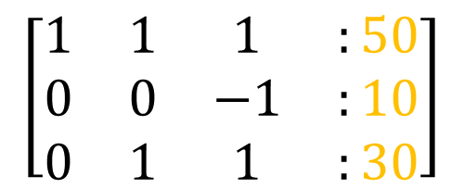

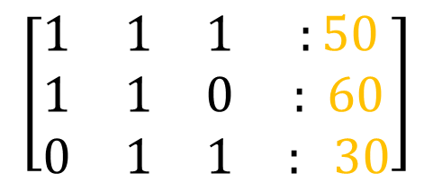


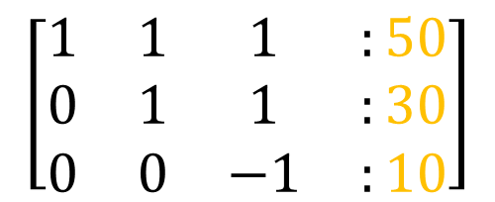
Solution using Gauss-Jordan Elimination Method
We represent the system as an augmented matrix:
Now, the system gives $z=−10$
$$\left[\begin{matrix}1 & 1 & 1 & :50 \\ 1 & 1 & 0 & : 60 \\ 0 & 1 & 1 & : 30\end{matrix}\right]$$
However, in the context of drone trips, negative values don’t make sense because $z$ represents the number of trips by Drone 3. You can’t have -10 trips!
This is a clear real-world inconsistency. The system of equations has no solution, which means the constraints are contradictory.
$$\left[\begin{matrix}1 & 1 & 1 & :50 \\ 0 & 0 & −1 & :10 \\ 0 & 1 & 1 & :30\end{matrix}\right]$$
$$R_{2}−R_{1}$$
In practical terms, this inconsistency could indicate:
Conflicting Operational Constraints: The company may have set impossible rules, like assigning more trips than the total capacity.
Resource Allocation Error: Trying to distribute trips in a way that exceeds drone capabilities.
Error in Planning: The constraints don’t align with the reality of the system, and adjustments are needed.
$$\left[\begin{matrix}1 & 1 & 1 & :50 \\ 0 & 1 & 1 & :30 \\ 0 & 0 & −1 & :10\end{matrix}\right]$$
$$R_{3}⟷R_{2}$$

Slide 10
Design of Traffic Patterns
The network in Figure (next slide) shows a proposed plan for the traffic flow around a new park that will house the Liberty Bell in Philadelphia, Pennsylvania. The plan calls for a computerized traffic light at the north exit on Fifth Street, and the diagram indicates the average number of vehicles per hour that are expected to flow in and out of the streets that border the complex. All streets are one-way.
(a) How many vehicles per hour should the traffic light let through to ensure that the average number of vehicles per hour flowing into the complex is the same as the average number of vehicles flowing out?
(b) Assuming that the traffic light has been set to balance the total flow in and out of the complex, what can you say about the average number of vehicles per hour that will flow along the streets that border the complex?

Slide 11
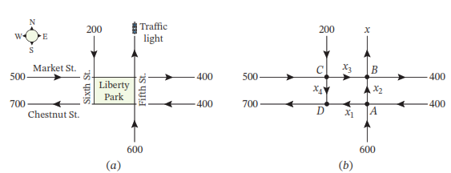
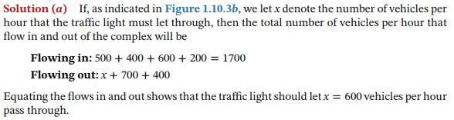

Slide 12
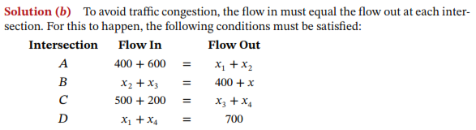
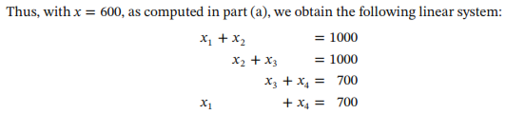

Slide 13
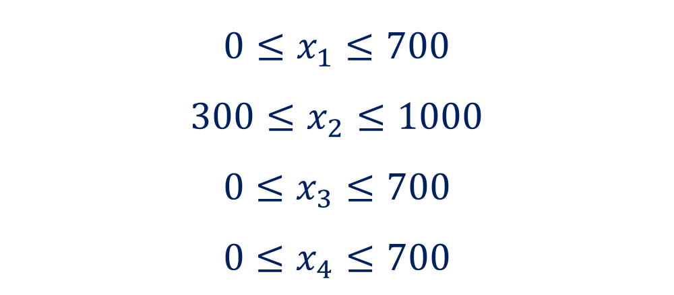
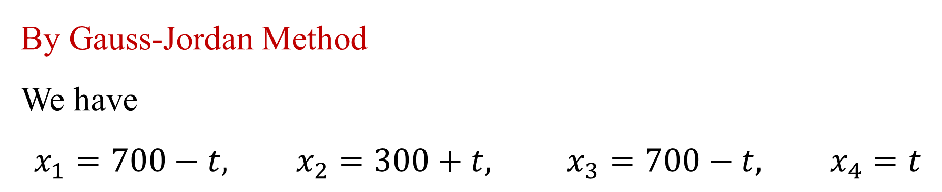
By Gauss-Jordan Method
We have
$$x_{1}=700−t, x_{2}=300+t, x_{3}=700−t, x_{4}=t$$
However, the parameter t is not completely arbitrary here, since there are physical constraints to be considered.
So, we have
$$0≤x_{1}≤700$$
$$300≤x_{2}≤1000$$
$$0≤x_{3}≤700$$
$$0≤x_{4}≤700$$

